Slide 1

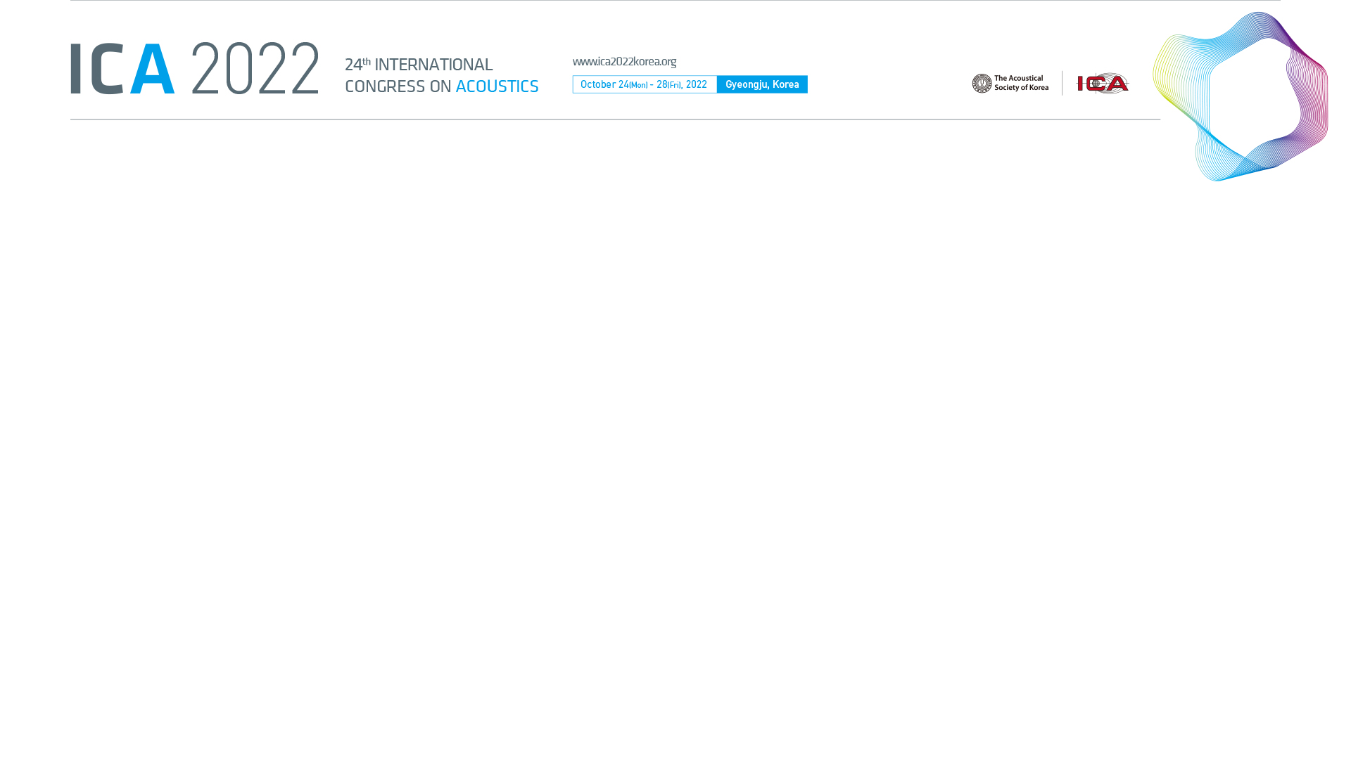
Using spatialized water sound sequences for traffic noise mitigation:
correlation analysis of subjective evaluation and neural measurements
Jian LI; Luigi MAFFEI; Aniello PASCALE; Massimiliano MASULLO
Department of Architecture and Industrial Design,
Università degli Studi della Campania “Luigi Vanvitelli”, Italy

Slide 2
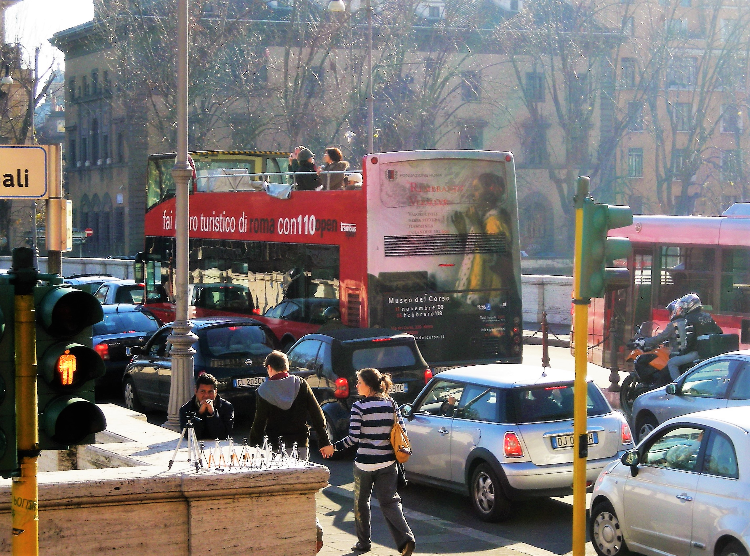
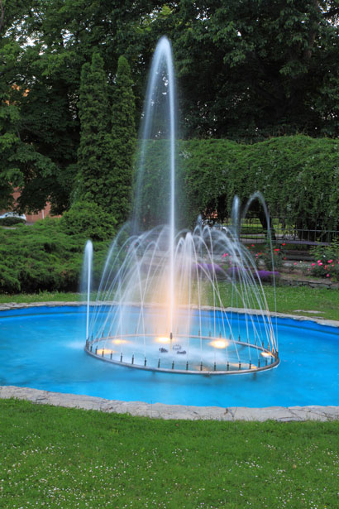
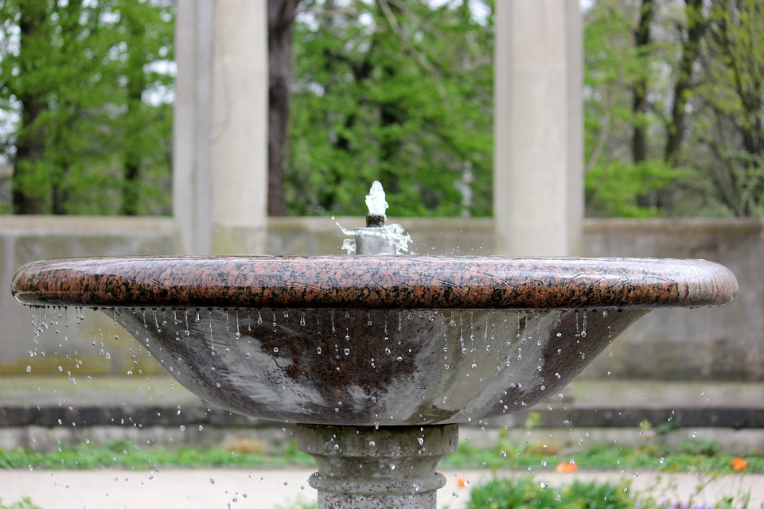
Introduction
1) traffic noise and water sound
Traffic noise is a big concern for urban designers and landscape managers since it has been proven to impact public health physically and mentally.
The introduction of natural sounds (e.g. water sounds, bird songs) into noisy urban environments has been treated as an effective strategy for noise reduction and abatement. Among them, water sounds are commonly used to mask traffic noise varying in its sound features.
Evidence showed that to optimize the effects of the Informational Masking the sound level of water sound should be -3dB than the traffic noise.
Question: Can the spatial setting of water sounds improve the masking effect on road traffic noise?
From https://ec.europa.eu/research-and-innovation/sites/default/files/hm/field/image/noise%20rome.jpg
From https://www.maxpixel.net/static/photo/1x/

Slide 3
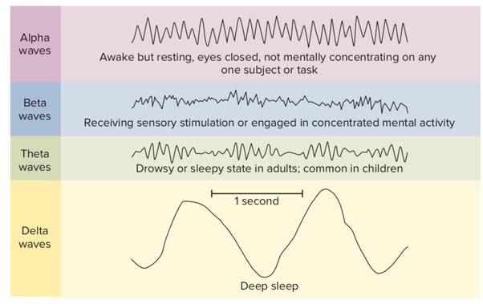
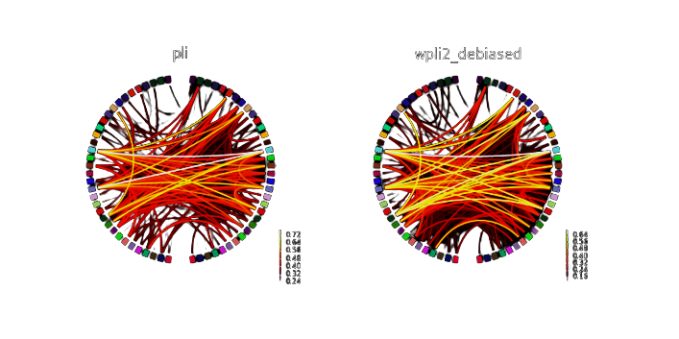
Introduction
2) the application of EEG (electroencephalogram)
- Neural oscillation
Neural oscillations are rhythmic electrical activity generated in the central nervous system, spontaneously and in response to external events, which could be used as indicators of sonic environments related to the comfort and restoration of individuals.
- Brain connectivity
Brain functional connectivity is defined as the statistical relationships between cerebral signals over time and thus potentially allows conclusions to be made regarding the functional interactions between two or more brain regions (Gaudet, Isabelle, et al. 2020).
From Perrotta, G. (2019). Sleep-wake disorders: Definition, contexts and neural correlations. J Neurol Psychol, 7(09)
From https://mne.tools/0.13/auto_examples/connectivity/

Slide 4
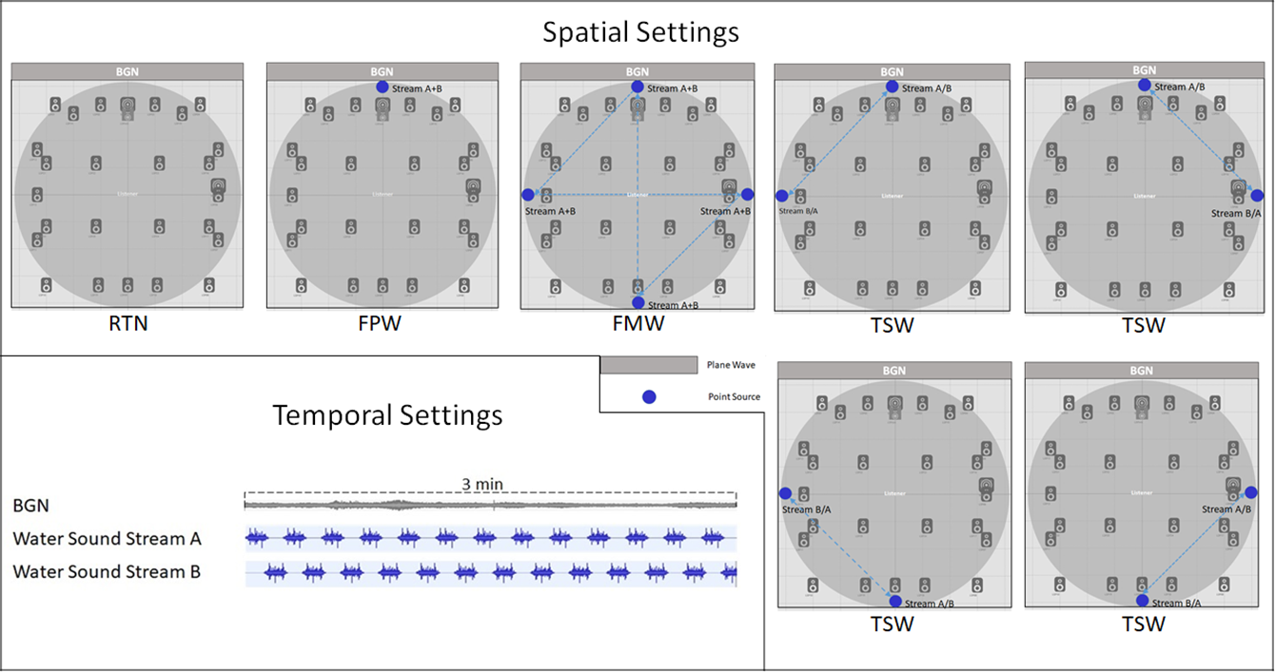
Experiment Design
1) the independent variable
The spatial settings of the water sounds:
Frontal-fixed Position Water sound (FPW)
Two-position Switching Water sound (TSW)
Four-position randomised Moving Water sounds (FMW)
Road Traffic Noise (RTN)

Slide 5
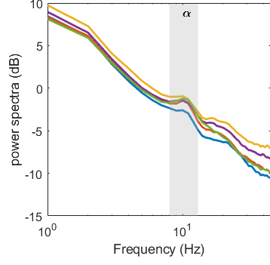
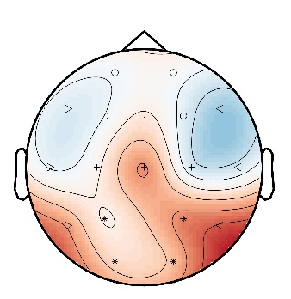
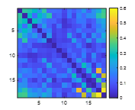
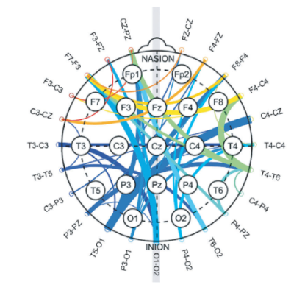
Experiment Design
2) the dependent variables
Post-doc questionnaire:
Objective descriptors
naturalness, mechanicalness, smoothness, rhythmicalness, spaciousness, and familiarity
Positive component of emotional saliency (ES+):
pleasant, happy, stimulating, attractive, energetic, calm;
Negative component of emotional saliency (ES-):
boring, unpleasant, nervous, weak, sad, unattractive
EEG measurements:
spectral power distribution (frequency bands: delta/theta/alpha/beta/gamma)
theta/alpha ratio + alpha/beta ratio
brain connectivity (dwPLI)

Slide 6
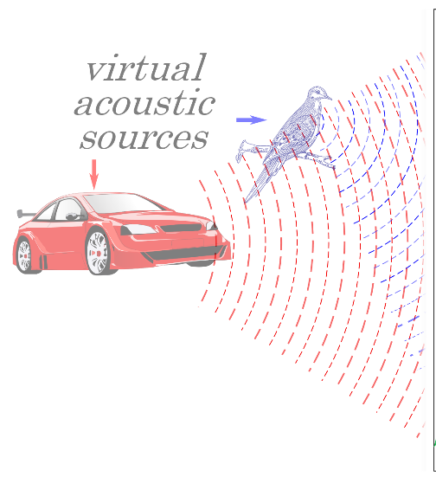
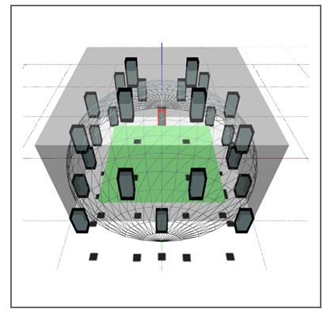
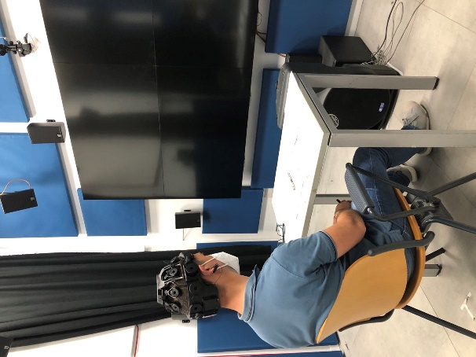
Experiment Procedure
1) the playback of sounds
Place:
Sens i-Lab, the Department of Architecture and Industrial Design
Sound system:
Astro Spatial Audio (25 Adorn A55 Martin Audio; 2 Sx110 Martin Audio; SARA II Premium Rendering Engine)
Spatial sound settings:
> Plane wave: traffic noise
Recorded from: a real urban park (65 dB(A))
> Point source: water sounds
Recorded from: a water stream (62 dB(A))

Slide 7
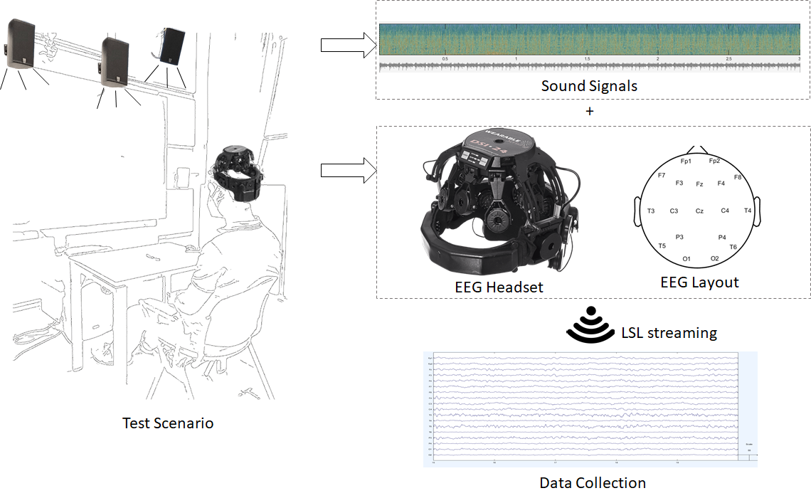
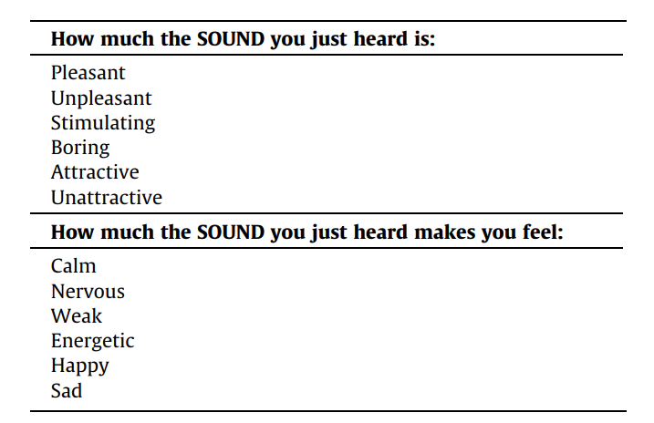
Experiment Procedure
2) data collection
The brain signals of twenty subjects were measured by a wearable EEG headset (DSI-24).
After 3 minutes of listening for each condition, subjects were asked to answer the questionnaires. The listening orders of four conditions were balanced across subjects.

Slide 8
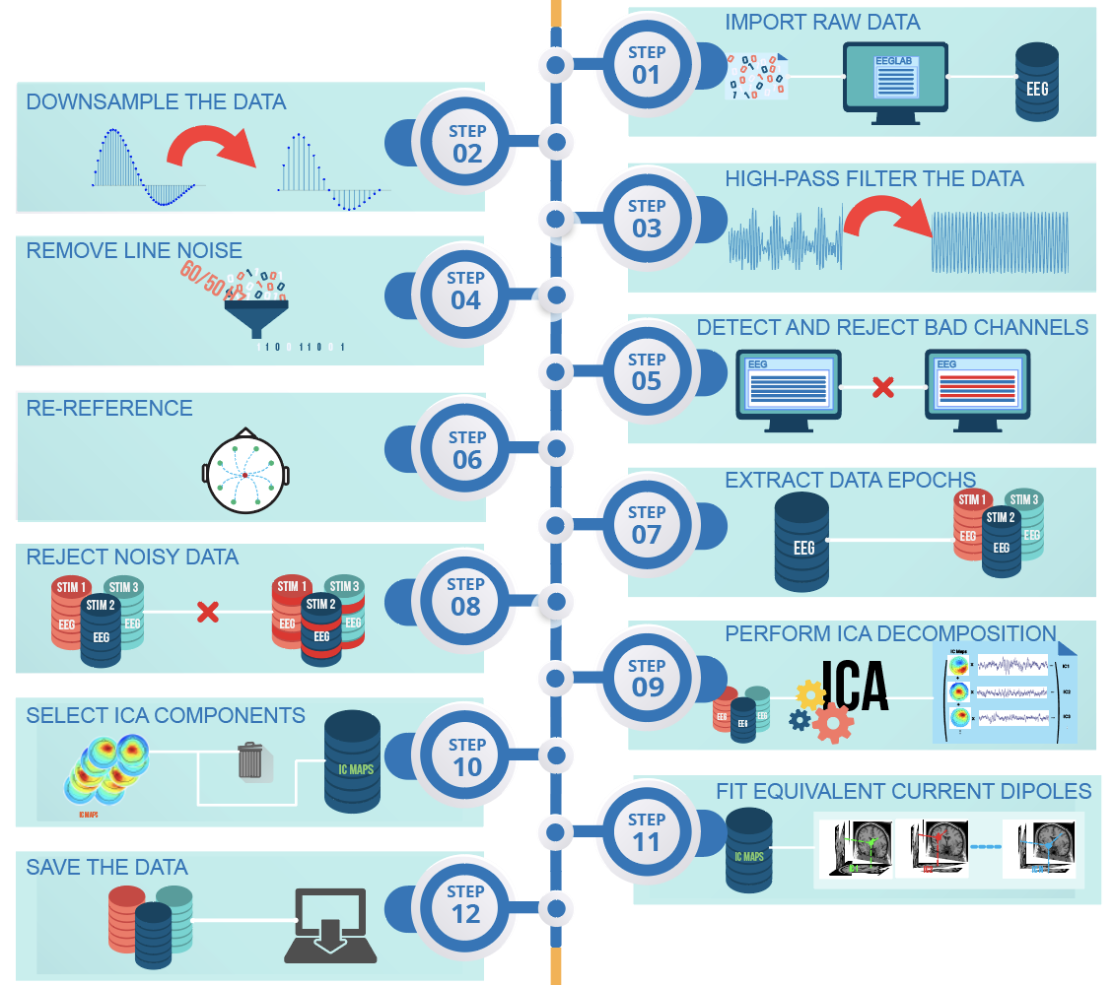
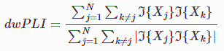
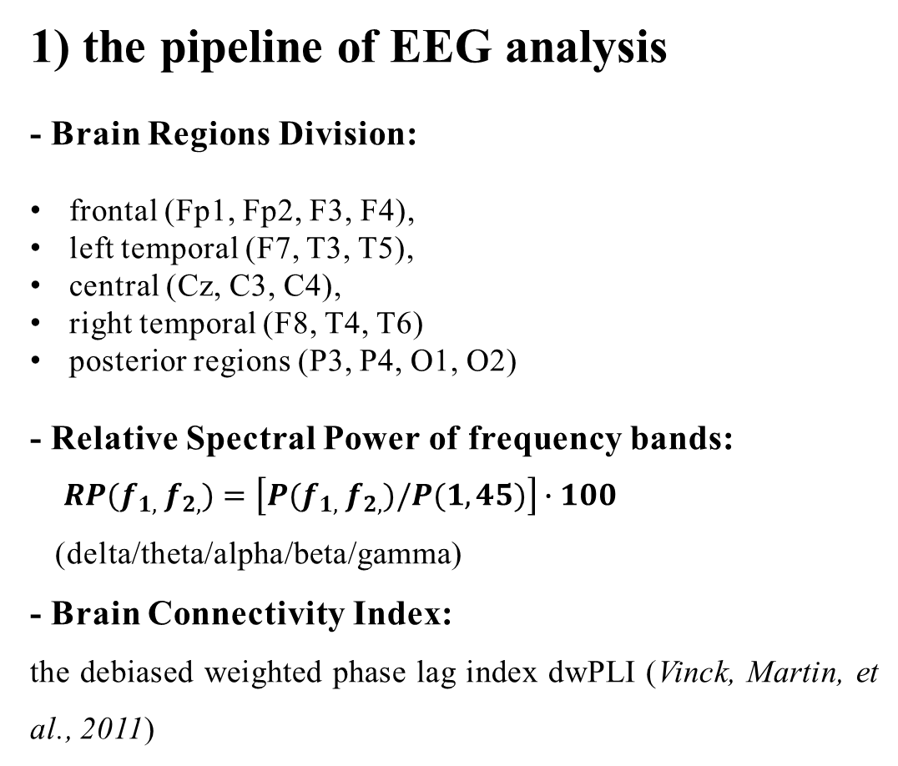
Data Analysis
1) the pipeline of EEG analysis
- Brain Regions Division:
frontal (Fp1, Fp2, F3, F4),
left temporal (F7, T3, T5),
central (Cz, C3, C4),
right temporal (F8, T4, T6)
posterior regions (P3, P4, O1, O2)
- Relative Spectral Power of frequency bands:
$RP(f_{1,}{ f}_{2,})=\left[P(f_{1,}{ f}_{2,})/P(1,45)\right]∙100$
(delta/theta/alpha/beta/gamma)
- Brain Connectivity Index:
the debiased weighted phase lag index dwPLI (Vinck, Martin, et al., 2011)
From https://eeglab.org/assets/images/tutorial_image.png

Slide 9
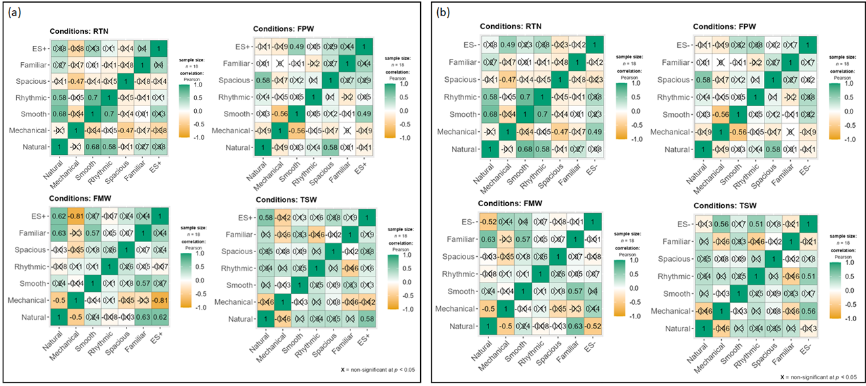
Results
1) Correlation results: subjective descriptors - emotional salience

Slide 10
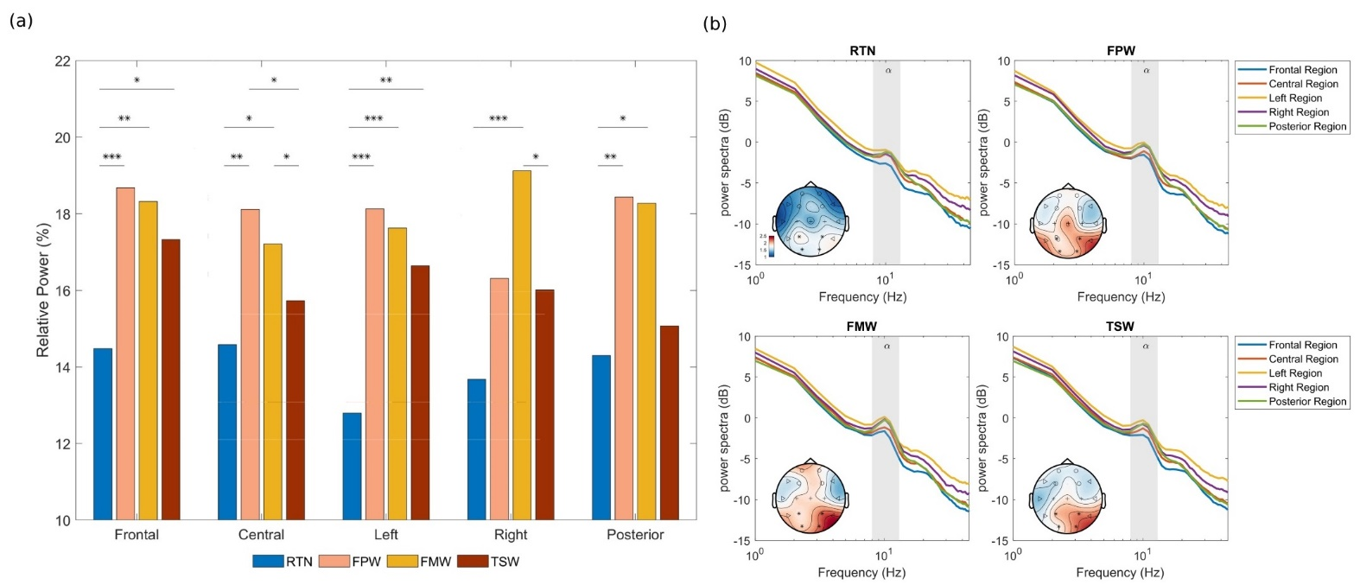
Results
2) The results of EEG spectral power across different conditions and brain regions

Slide 11
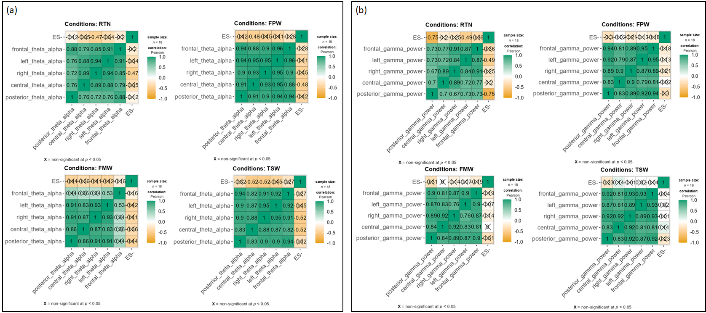
Results
3) The correlation results of theta alpha ratio, gamma power and emotional salience

Slide 12
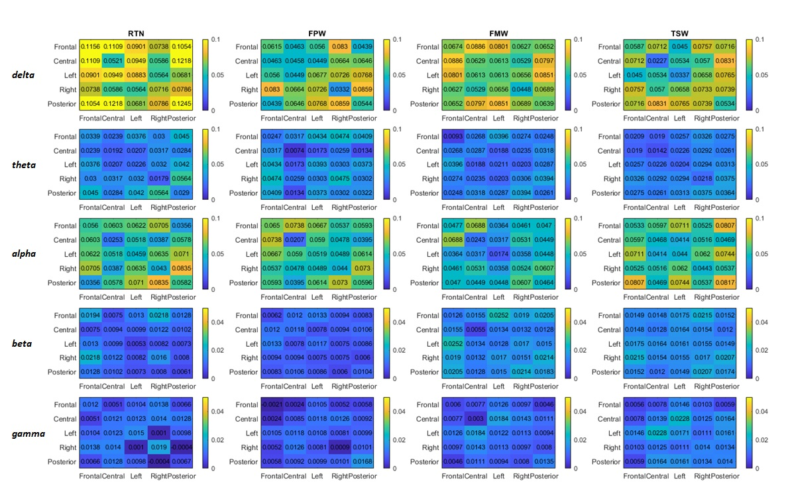
Results
4) The results of connectivity analysis across different conditions and frequency bands

Slide 13
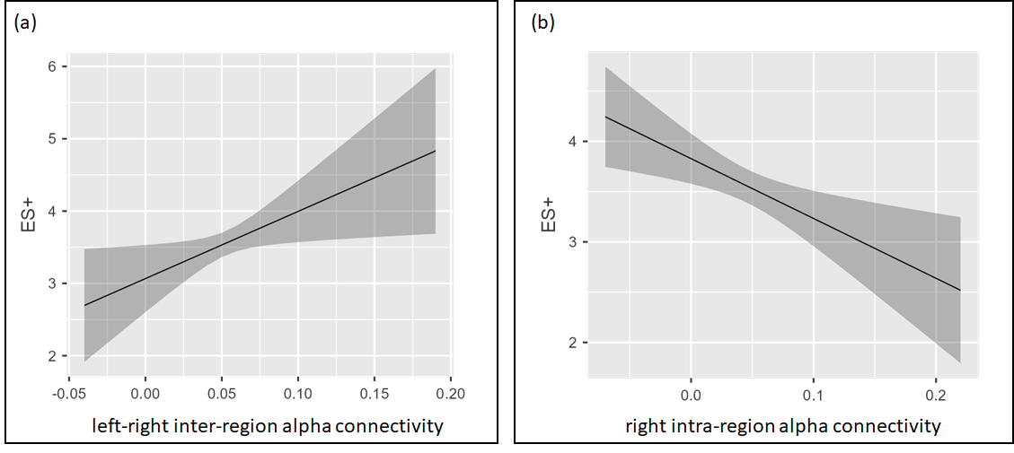
Results
5) The correlation results of left-right alpha , intra-right alpha connectivities and emotional salience

Slide 14
Conclusions
1) the mechanical road traffic noise influenced both the positive and negative components of the emotional saliency. Natural features are inversely correlated to ES-.
2) the overall effects of the alpha band power revealed the positive effects of spatial settings react on ES+ scores, and the difference between left-right inter-region and right intra-region alpha connectivity related to the ES+ scores differently no matter of the water sound conditions or only traffic noise.
3) the spectral power of the gamma band and the theta alpha ratios used as the cognitive load index had shown relationship with the negative emotional salience that need further and deeper investigations.

Slide 15
End
Thank you!

